Slide 1


Slide 2

Java OOP and Data Structures with Introduction to Secure Coding Dr. Ziping Liu
Chapter 9 Abstraction: Abstract Classes and Interfaces

Slide 3
https://he.kendallhunt.com/product/java-oop-and-data-structures-introduction-secure-coding
Chapter 9 Abstraction: Abstract Classes and Interfaces

Slide 4

Chapter Outlines
Defining and using abstract classes
Defining and using interfaces
Sneaking a peek at ArrayList, a datatype from the Java Collections framework
Leveraging predefined interfaces from the Java libraries
Cloneable
Comparable
Comparator

Slide 5
9.1 What is an Abstract Class?
concrete class: can be used to create objects
dynamic class for each object had fully implemented methods
abstract classes: CANNOT be instantiated to create objects
can have instance and static variables,
can have concrete (fully implemented) methods
one or more of the member methods may be abstract
An abstract method is an empty method header, without any implementation details

Slide 6
9.1 What is an Abstract Class?
Abstract classes allow inheritance relationships
a subclass can be either concrete or abstract
concrete subclasses of an abstract class must override and implement any abstract methods that they inherit
abstract classes can also define default and explicit-value constructors
concrete subclasses of an abstract class may invoke the abstract class’s constructor(s) through a super() call when objects of the concrete subclass are instantiated

Slide 7
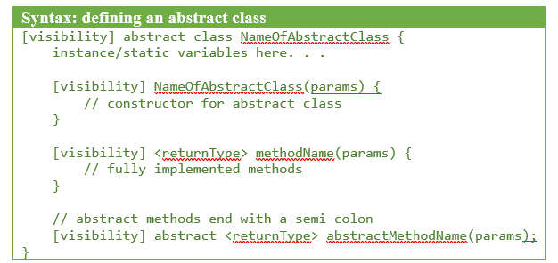
Defining an Abstract Class

Slide 8
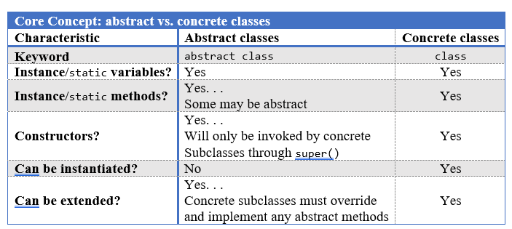
Abstract Classes vs. Concrete Classes

Slide 9
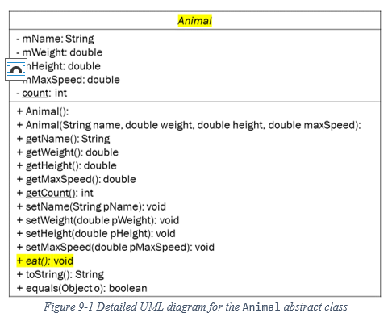
UML diagram for the Animal abstract class
Pet rufus = new Pet("Rufus", 30.9, 0.89, 50.5, "Peter");
Animal rufusAsAnAnimal = rufus;
assign an object belonging to a concrete subclass to a variable of an abstract superclass

Slide 10
9.2 Interfaces
group related methods under one umbrella “type,” but allow the implementation of those methods to vary
share methods without creating an inheritance relationship

Slide 11
9.2 Interfaces
In Java, an interface can contain method signatures—method headers with the method name, return type, and parameters, but no implementation or method bodies. Classes, both abstract and concrete, can implement an interface by providing the specific implementations for the interface’s method headers. Different classes can choose different method implementations, allowing software engineers to flexibly control the dynamic behavior of programs.

Slide 12
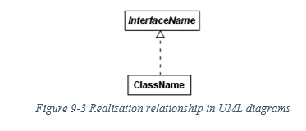
The Realization Relationship
any class that wants to use the interface’s methods and realize the method headers can implement the interface
Descendants of a realization relationship satisfy the “is a” typing for polymorphism

Slide 13
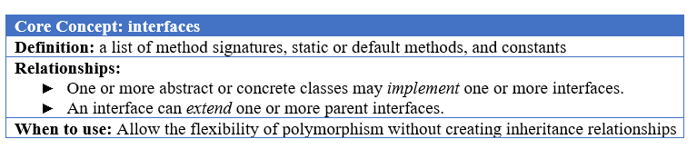
The Realization Relationship

Slide 14
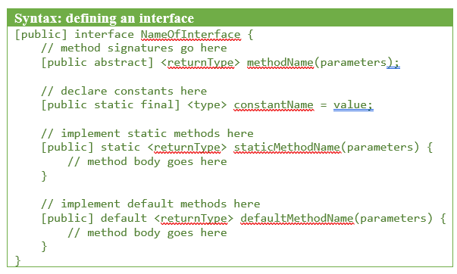
Defining an Interface
some keywords for an interface are optional:
the visibility of the interface itself, its methods, and its constants are all implicitly public
interface method signatures are abstract
interface constants are implicitly static and final

Slide 15
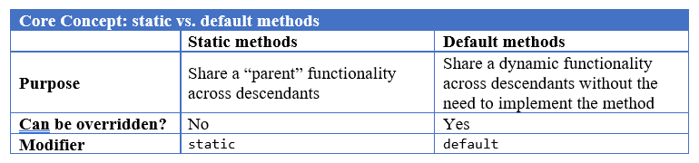
Defining an Interface

Slide 16
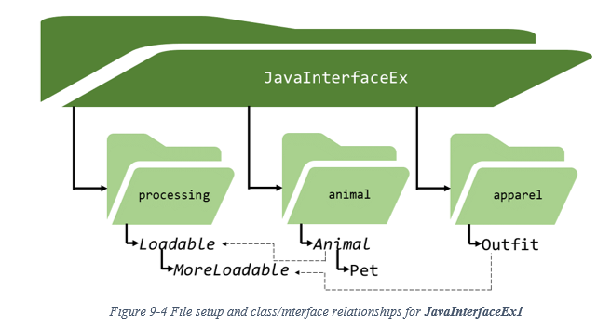
Defining an Interface

Slide 17


Slide 18


Slide 19
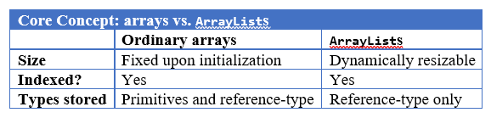
9.3 Introducing ArrayList

Slide 20
9.4 Pre-defined Java Interfaces
Cloneable
marker interface: does not contain any methods or constants
the purpose of a marker interface is to highlight specific traits of objects
If a class implements the Cloneable marker interface, it generally also overrides the clone() method from the Object superclass

Slide 21
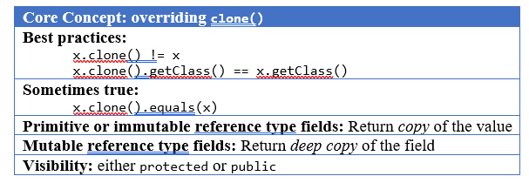
9.4 Pre-defined Java Interfaces
Cloneable

Slide 22
9.4 Pre-defined Java Interfaces
Comparable
In order to compare two reference-type objects, we will need to implement the Comparable interface. Java has provided the Comparable interface to standardize comparisons of reference-type objects:
public interface Comparable<T> {
public int compareTo(T other);
}

Slide 23
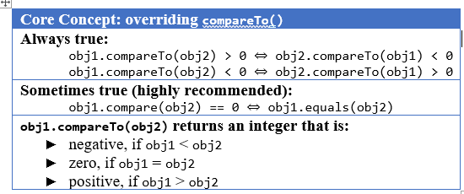
9.4 Pre-defined Java Interfaces
when a class implements the Comparable interface, the class is said to have a natural ordering (a particular way of ordering items from “least” to “greatest”)

Slide 24
9.4 Pre-defined Java Interfaces
Comparator
Reference-type objects with multiple member fields may need to have flexible comparison rules—options for how we want to compare them. The Java Comparable interface only allows us to define one ordering, the natural ordering rule. To have flexible comparison rules, we will need to use the Java Comparator interface.
supports total ordering comparison
Classes that implement Comparator are standalone classes that define rules for comparing other classes

Slide 25
Which National Park is it?
Answer: Redwood National Park

